Slide 1

THE FUTURE BEGINS TODAY

Slide 2
The Development Consortium Background
Founded in 2006
Female Majority Owned Illinois S- Corporation
Focus Areas
Site Selection/Incentive Negotiation
Illinois Enterprise Zones
Economic Development Plan Reviews/Development
Organizational Management
Non- Profit Management
  Edgar Fellows
  Elevate Illinois

Slide 3
The Development Consortium Background
Janet M. Mathis-CEO/Co-Founder
Geneseo, IL
Comms/Advance - Edgar Admin
State Fair Comm. Mgr.
Trade Director - Canada
Area Rep DCCA/DCEO
CEO – Renew Moline
Past Chair – IEDA
Past Chair – Center for Youth & Family Services (CYFS)
Past Chair – River Bend Food Bank
Exec. Director – Edgar Fellows
Multiple Development Awards
J. Craig Coil – COO/Co-Founder
Petersburg, IL
Marketing/Promotions – Six Flags St. Louis
Economic Dev. Rep – DCCA
Targeted Industry Spec. – DCCA
Div. Mgr. – Industry/Market Dev. – DCCA
Senior Corp Services Mgr. – DCCA
CEO – EDC of Decatur & Macon County
Foreign Trade Zone Manager
Enterprise Zone Legislative Rewrite Partner
Past Board Chair – IEDA & IEZA
Multiple Development Awards

Slide 4
THE STUDY
RISE Grant Awarded
Interviews With Village Leadership
Development Priorities Identified and Discussed
Local & External Interviews (40+)
Peer Community Research
Project Cost Research/Analysis
Infrastructure Analysis
Public Safety Update
Commuting Pattern & Traffic Count Comps
Education & Workforce Pipeline/ Training Review
IMPLAN Economic Impact Study – WIU/RETAC

Slide 5
Internal perceptions
Wide ranging agreement on the opportunities, challenges and potential growth benefits.
The MAJORITY related positively to the Priority Areas
Key Community Pride Statements: Education -- Public Safety -- Quality of Life
Agreement on the need to CREATE A COMMUNITY VISION
Make Chatham a Destination
Need for a CENTRAL POINT OF IDENTITY TO RALLY AROUND
More local services: RESTAURANTS/GOODS and SERVICES/CO-WORKING SPACES
Need for more local PRIMARY EMPLOYMENT
Need for more AFFORDABLE/WORKER HOUSING
Ball-Chatham Schools - A Mixed Bag
Development of a WORKER PIPELINE
Edwardsville and Petersburg frequently mentioned as “Models for Success”

Slide 6
External perceptions
Impressions of Chatham were usually NOT FACT BASED
Trapped in a Downstate Tunnel Vision Perceptions by Non- Residents
Location Advisors are focused on the metros: Springfield, Bloomington-Normal, Decatur, Champaign-Urbana, Metro-East, etc.
This is an issue, but in every issue, there is an OPPORTUNITY. This is illustrated by the response from one of the national site selection firm’s representatives who is originally from the Sangamon County market. He made the statement that it was:
  “…………unfathomable that more emphasis is not placed on marketing the region to warehouse/distribution operations along the I-55 corridor”

Slide 7
IMPACT DEFINITIONS
Output: Total value of production or revenues through the sale of goods or services;
Employment: Total combined full and part-time employment;
Labor Income: Employee compensation (wages, salaries, bonuses, benefits, social insurance contributions) and Income of Sole-Proprietors; and
Public Revenues: Annual increase in revenues for state/local and federal entities from activities within the study area.
Direct Effects: Impacts associated with the operations and employment at the point of change;
Indirect Effects: Changes in inter-industry purchases by the Direct Industry with its suppliers and consumers, and purchases and sales, stemming from the Direct economic activity, among their suppliers and consumers; and
Induced Effects: Changes in household spending by employees created/supported relative to the Direct and Indirect demand.

Slide 8
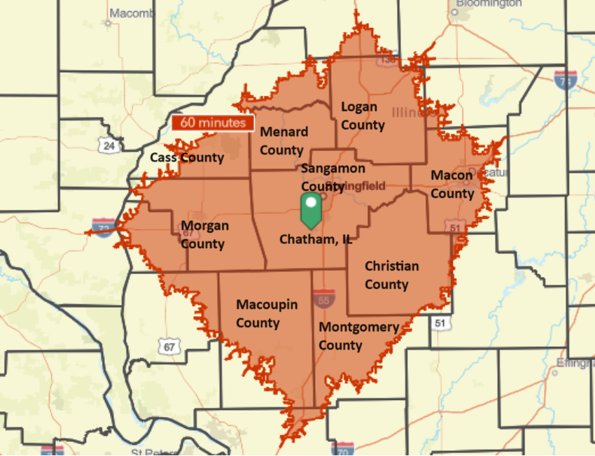
COMMUTING AREA

Slide 9
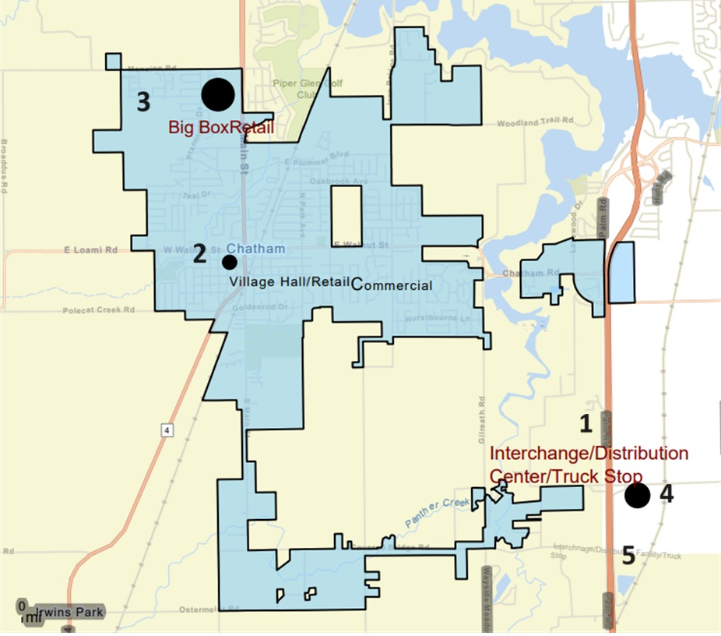
PROJECT AREA

Slide 10

MUNICIPAL CENTER

Slide 11
MUNICIPAL CENTER
Provides for:
  More Efficient Municipal Operations
  Opportunity for Needed Small Business Retail Space
  Opens Up Development Opportunities At The Current Site
  Begins to Create the Village Identity/Anchor

Slide 12
MUNICIPAL CENTER
Economic impacts on the primary region of analysis associated with construction of the new Chatham Municipal Building including area for retail/commercial activities
Construction Impacts
Levels of Impact | Output | Employment | Labor Income | Public Revenues
Direct | $8.8MM | 68 positions | $4.4MM | $818K
Indirect | .6MM | 7.1 positions | $514K | $218K
Induced | $3.1MM | 18.5 positions | $1.0MM | $415K
Total | $13.5MM | 93.6 positions | $6.0MM | $1.5MM

Slide 13
MUNICIPAL CENTER
Operational Impacts
Levels of Impact | Output | Employment | Labor Income | Public Revenues
Direct | $500K | 6.2 positions | $165K | $59K
Indirect | $170K | 0.9 positions | $56K | $18K
Induced | $150K | 0.9 positions | $48K | $20K
Total | $821K | 7.9 positions | $270K | $98K

Slide 14
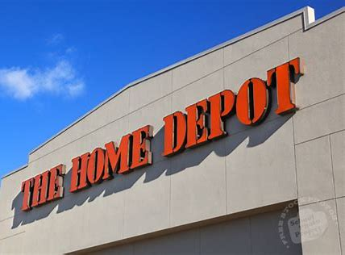
BIG BOX RETAIL
Home Depot Store Model
  From HD Annual Report
105.000 SF
  Sales Area - 91,350 SF
  Annual Sales - $56,592,450
  Sales Per Square Foot - $621
405 Full and Part-Time Jobs

Slide 15
BIG BOX RETAIL
Construction Impacts
Levels of Impact | Output | Employment | Labor Income | Public Revenues
Direct | $12.7MM | 97.3 positions | $6.4MM | $1.2MM
Indirect | $2.3MM | 10.3 positions | $742K | $318K
Induced | $4.5MM | 26.6 positions | $1.5MM | $598K
Total | $20.0MM | 134.2 positions | $8.6MM | $2.1MM

Slide 16
BIG BOX RETAIL
Operational Impacts
Levels of Impact | Output | Employment | Labor Income | Public Revenues
Direct | $56.6 MM | 405.3 positions | $17.7MM | $15.5MM
Indirect | $13.0 MM | 65.7 positions | $4.2MM | $1.4MM
Induced | $13.2 MM | 78.7 positions | $4.3MM | $1.8MM
Total | $82.8 MM | 549.7 positions | $26.1MM | $18.6MM

Slide 17
PULLIAM ROAD INTERCHANGE
Construction Impacts
Levels of Impact | Output | Employment | Labor Income | Public Revenues
Direct | $14.3MM | 85.4 positions | $6.5MM | $1.2MM
Indirect | $2.5MM | 10.8 positions | $764K | $399K
Induced | $4.5MM | 26.8 positions | $1.5MM | $603K
Total | $21.3MM | 122.9 positions | $8.7MM | $2.2MM

Slide 18
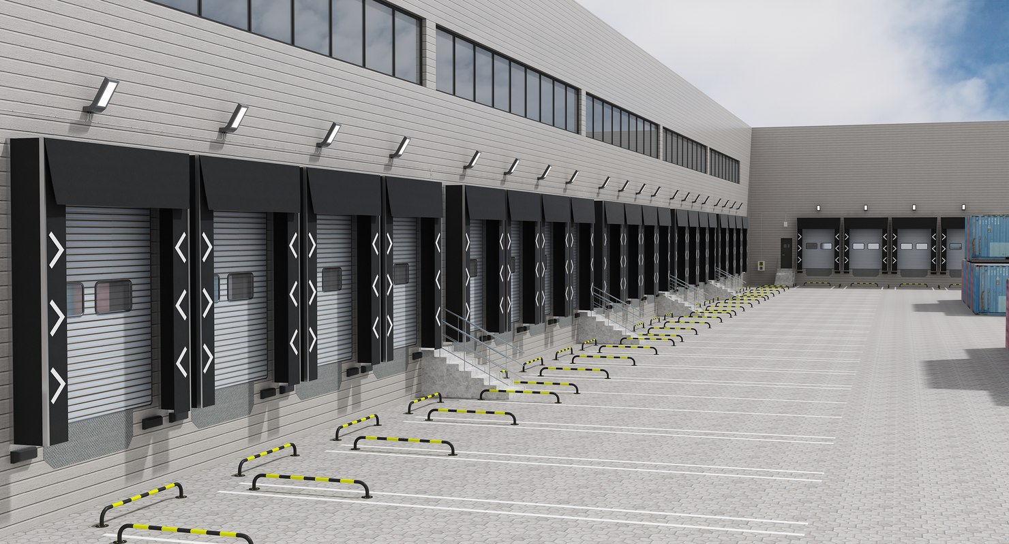
Warehouse/logistics center
100,000 SF
$20 M Construction Cost
$10 M M/E Cost

Slide 19
Warehouse/logistics center
Construction Impacts
Levels of Impact | Output | Employment | Labor Income | Public Revenues
Direct | $30.0MM | 231.5 positions | $15.1MM | $2.8MM
Indirect | $5.5MM | 24.3 positions | $1.8MM | $741
Induced | $10.5MM | 62.8 positions | $3.4MM | $1.4MM
Total | $46.0MM | 318.6 positions | $20.3MM | $4.9MM

Slide 20
Warehouse/logistics center
Operational Impacts
Levels of Impact | Output | Employment | Labor Income | Public Revenues
Direct | $30.0MM | 299.7 positions | $15.3MM | $3.0MM
Indirect | $11.2MM | 59.1 positions | $3.5MM | $1.2MM
Induced | $11.6MM | 69.0 positions | $3.8MM | $1.6MM
Total | $52.7MM | 427.8 positions | $22.6MM | $5.8MM

Slide 21
Economic IMPACT summary
Annual Impacts of Construction Projects on Primary Region of Analysis (Sangamon County)
Construction Projects | Output | Employment | Labor Income | Public Revenues
I-55 Interchange | $21.3MM | 122.9 positions | $8.7MM | $2.2MM
Municipal Building | $13.5MM | 93.6 positions | $6.0MM | $1.5MM
Warehouse/Logistics | $46.0MM | 318.6 positions | $20.3MM | $4.9MM
Big Box Retail | $20.0MM | 134.2 positions | $8.6MM | $2.1MM
Truck Stop | $5.8MM | 37.6 positions | $2.5MM | $610K

Slide 22
Economic IMPACT summary
Annual Operational Impacts of Projects on Primary Region of Analysis (Sangamon County)
Business Projects | Output | Employment | Labor Income | Public Revenues
Municipal Building | $797K | 7.8 positions | $264K | $94K
Warehouse/Logistics | $52.7MM | 427.8 positions | $22.6MM | $5.8MM
Big Box Retail | $82.8MM | 549.7 positions | $26.1MM | $18.6MM
Truck Stop | $9.8MM | 63.3 positions | $3.2MM | $1.7MM

Slide 23
  NOW WHAT?

Slide 24
  QUESTIONS?

Slide 25

J. Craig Coil
888-586-3555 ext. 102
ccoil@tdccconsult.com
www.tdcconsult.com

